Slide 1
ONLINE BOOK STORE
ID.NO NAME
2200032617 G.SANJANA
2200032081 P.BHAVANA

Slide 2
Contents:
►Abstract
► Introduction
►Challenges in online book store
►Benefits
►Technology integration
►Customers feedback
►conclusion

Slide 3
Abstract:
In the process of the improvement of the people’s living standard, people’s demands of the life’s quality and efficiency is more higher, the traditional bookstore’s inconvenience gradually emerge, and the online bookstore has gradually be used in public. The online bookstore is a revolution of book industry

Slide 4
Introduction:
The online bookstore is a form of e-commerce and book sales industry in one form, it has many advantages, such as: Bookstore size is relatively small, cost savings; transaction activities can be anytime, anywhere, improve service efficiency[2], The information is complete, more convenient retrieval [3], the new book information on the new, consumers can see in a timely manner, trading activities can be launched immediately, so online bookstore in today's era of development is extremely rapid

Slide 5
Challenges in online book store:
Building trust: Establishing trust with online shoppers who can't physically browse your selection can be difficult.
Marketing effectively: Reaching your target audience and standing out from the competition requires effective marketing strategies.
Customer loyalty: Encouraging repeat business in a competitive landscape requires excellent customer service and unique offerings.

Slide 6
Benefits:
Unlimited capacity
Customer Convenience
Enhanced customer experience
Accessibility
Exposure

Slide 7
Technology used:
HTML
CSS
JavaScript
React
Node JS, Express JS and MongoDb is used for Backend server which is deployed on Vercel.

Slide 8
Customers feedback

Slide 9
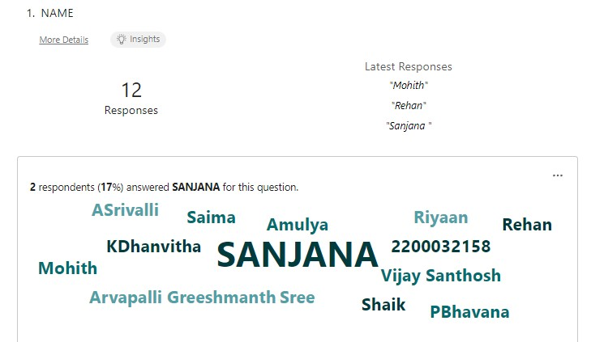

Slide 10
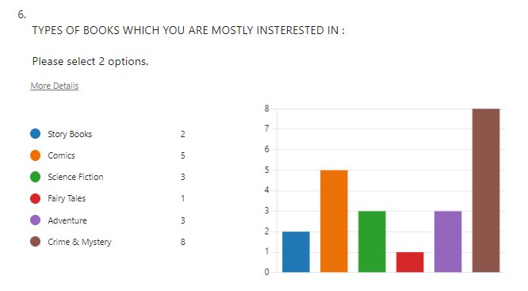
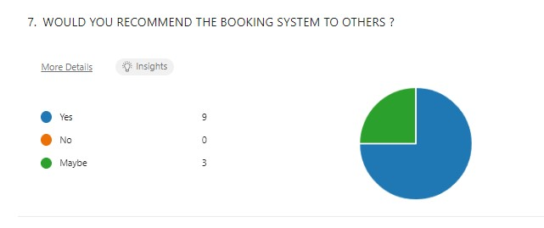

Slide 11
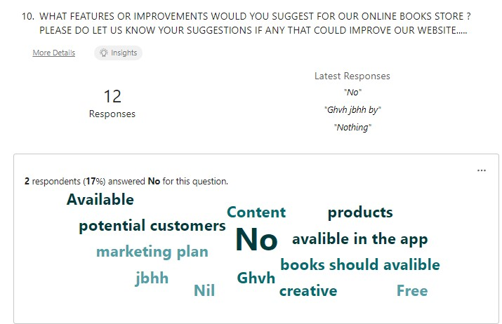

Slide 12
Conclusion:
Online bookstore has many advantages compared to its counterparts such as physical book store, the online bookstore allows it's user to shop at one place where in physical store the books are scattered at the different places which consumes a lot of time and online bookstore helps in saving that time and it also avoids the problem of unavailability of books at physical store as numerous vendors from different places sell their books at one place.

